Slide 1

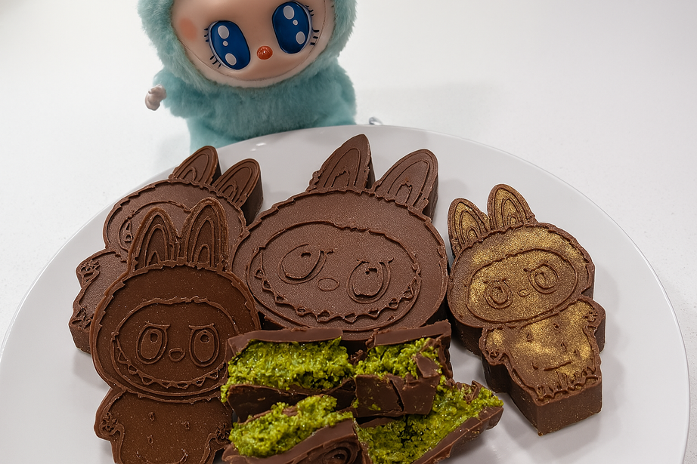
DAT 490: Data Science Capstone
THE LIFECYCLE OF A DIGITAL FOOD TREND
AN ANALYSIS OF FOOF TRENDS ACROSS YOUTUBE, REDDIT, AND GOOGLE TRENDS
Kadeeja Zumreen
Sriya Kondury
Sayalee Chivate
December 5th, 2025

Slide 2
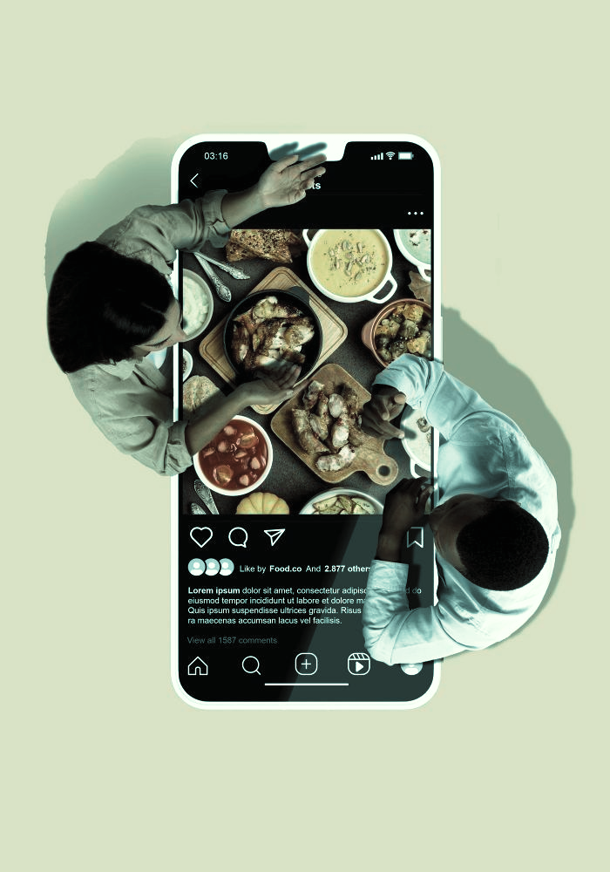




Why Online Food Trends Matter
Social Media drives food trends at an unprecedented pace, turning niche ideas into global phenomena overnight.
These fast-moving trends influence consumer behavior, product demand, and cultural food practices.
Our exploratory findings shows clear rise-peak-decline patterns across platforms, revealing measurable lifecycle stages.
Understanding these dynamics helps identify which trends become lasting cultural shifts versus short-lived viral moments.
Research Focus

Slide 3
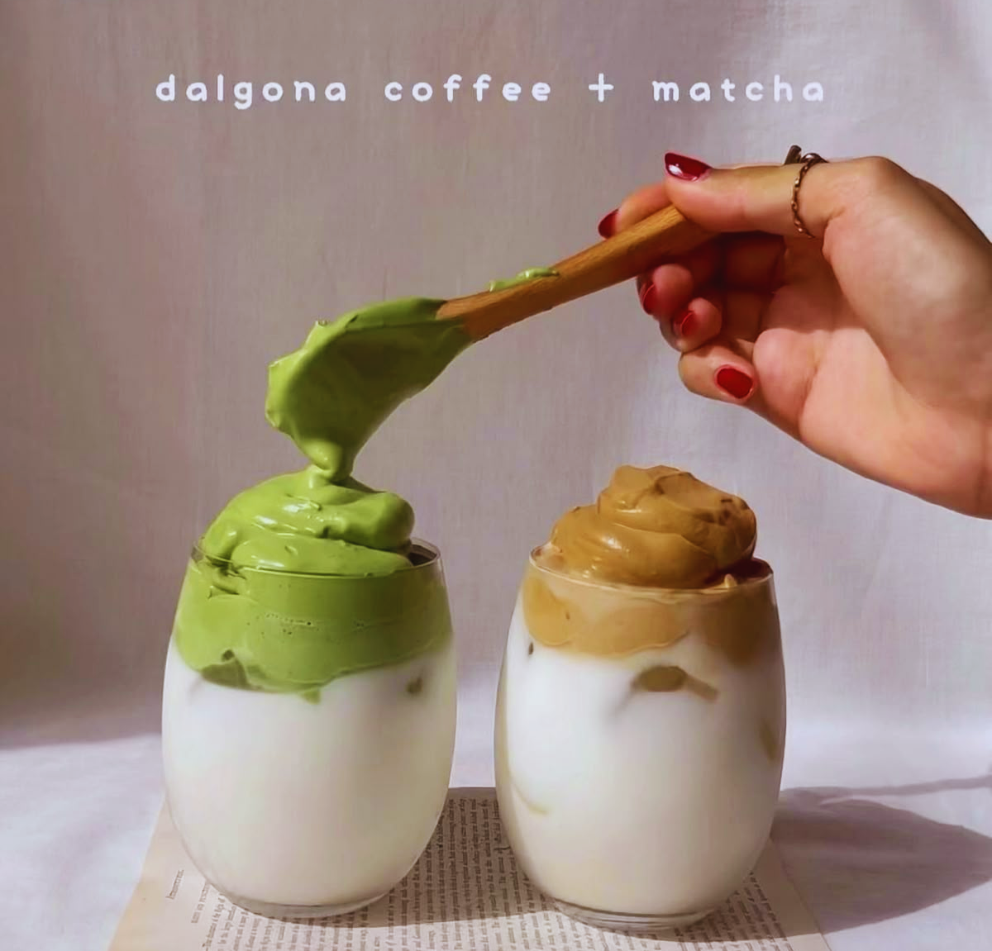





OUR RESEARCH
FOCUS
Identify the factors (conversations, sentiment, and visibility) that drive a food trend’s rise and decline.
Peak
Determine whether early online signals (engagement, sentiment, search interest) can predict a trend’s peak and longevity.
Emergence
Decline
Understand how interest in food trends evolves across regions and how different markets adopt trends at different intensities.
To understand how online activity across social media platforms reflects and predicts the rise, peak, and decline of modern food trends.
Thynk Unlimited
Key Theories

Slide 4
01
Diffusion of Innovations (Rogers, 1983)
KEY THEORIES BEHIND
TREND LIFECYCLES
This classic model explains how new ideas spread through a population in a predictable S-curve, moving from a few innovators to the mainstream. It provides the framework for a trend's rise.
These theories provide the conceptual basis for understanding rise, peak, and decline behavior in our trend lifecycle analysis.
02
The Fashion Cycle (Simmel, 1957)
A sociological theory explaining why trends are cyclical. Once a trend becomes mainstream, it loses its uniqueness and "cultural capital," which explains its eventual decline.
03
Food Neophobia
A key psychological barrier that explains why many trends fail. The reluctance to try unfamiliar foods can halt a trend's spread before it reaches mass adoption, creating a crucial friction point in the lifecycle.
Methodology

Slide 5




Data Sources
YouTube
Video metadata
Engagement metrics (views, likes, comments)
We collected and analyzed data from three key digital platforms to capture different dimensions of online food trends.
Reddit
Post Discussions
Sentiment
Community-driven reactions
Google Trends
Search interest
Regional Diffusion Patterns

Slide 6




Standardized timestamps, removed duplicates, and aligned all datasets by Date and Trend_ID
Data Cleaning and Feature Engineering
Engineered features: engagement rate, video age, sentiment score, post length, and title length
Cleaned Reddit text (lowercasing, removing links/punctuations) and created document-term matrices
Validated Google Trends data, removed partial weeks, and synchronized weekly values across regions

Slide 7

Exploratory Data Analysis
Overview
WHAT WE EXAMINED:
Time series patterns of video uploads, engagement and search interest.
Geographic diffusion of trends across four countries using normalized search indices.
01
02
Reddit sentiment and word distributions to explore public tone and discussion themes.
Cross-platform alignment: Comparing Google, YouTube and Reddit activity over time.
03
04

Slide 8



1
3
2
Regression
Analysis
LDA
Topic Modeling
Random Forest
Used to see if early engagement and sentiment can predict how the trend will spread throughout various regions.
Used to analyze engagement and content features most influential to Youtube
Used to find themes in Reddit conversations and analyze different conversations across different trends.
STATISTICAL AND MACHINE LEARNING METHODS
Results

Slide 9
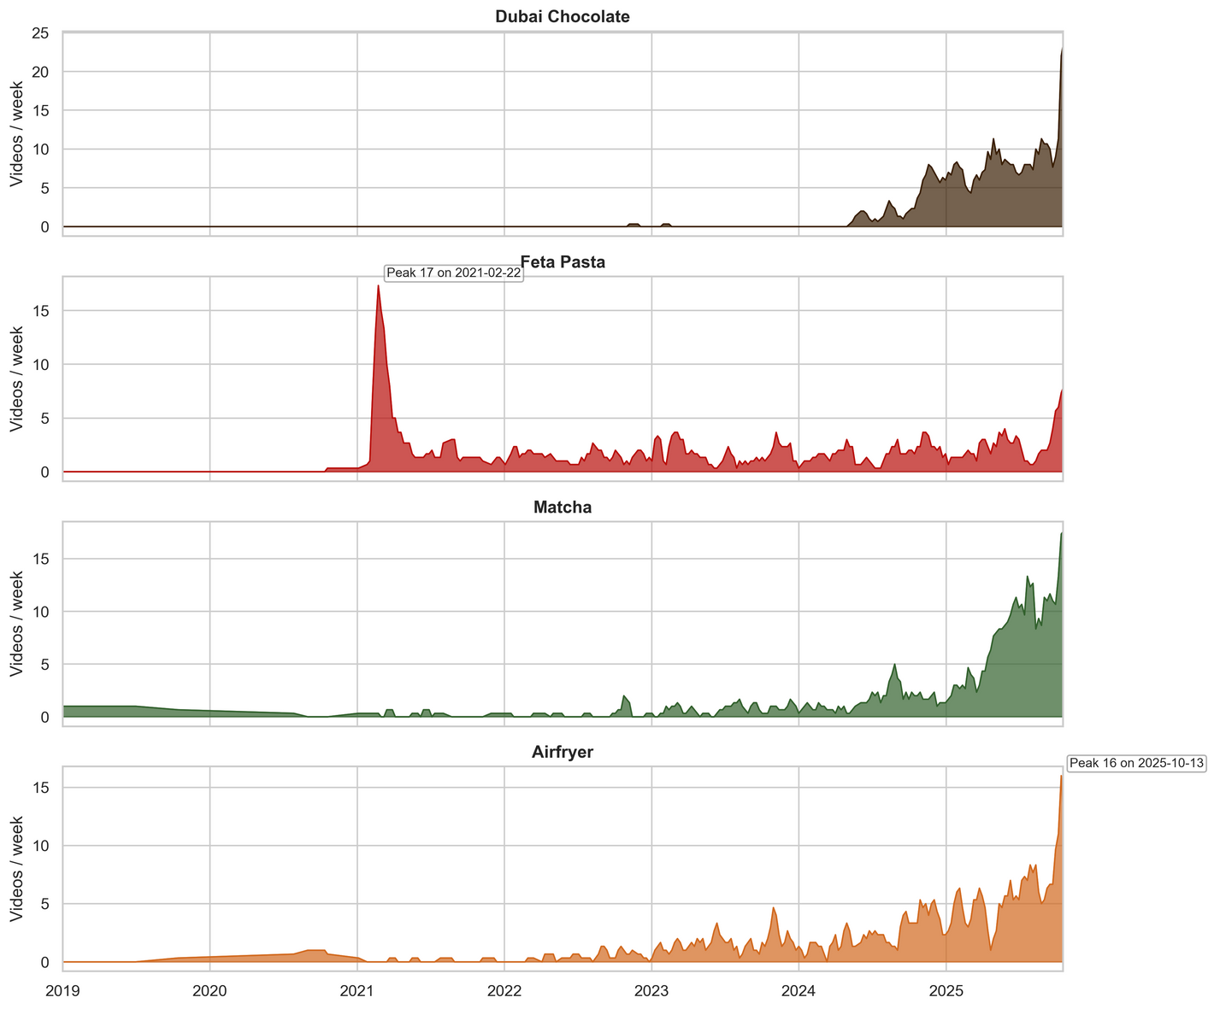


TREND DYNAMICS
ON YOUTUBE
Line plot showing number of YouTube videos uploaded per week for each trend (2019–2025) to show how how posting activity mirrors virality and long-term relevance.
PURPOSE
Feta Pasta shows a short, sharp spike in early 2021, aligning with its viral moment
Matcha and Air Fryer show steady, long-term growth, reflecting sustained interest.
Dubai Chocolate emerges rapidly in 2025, showing early viral potential.
INSIGHTS

Slide 10

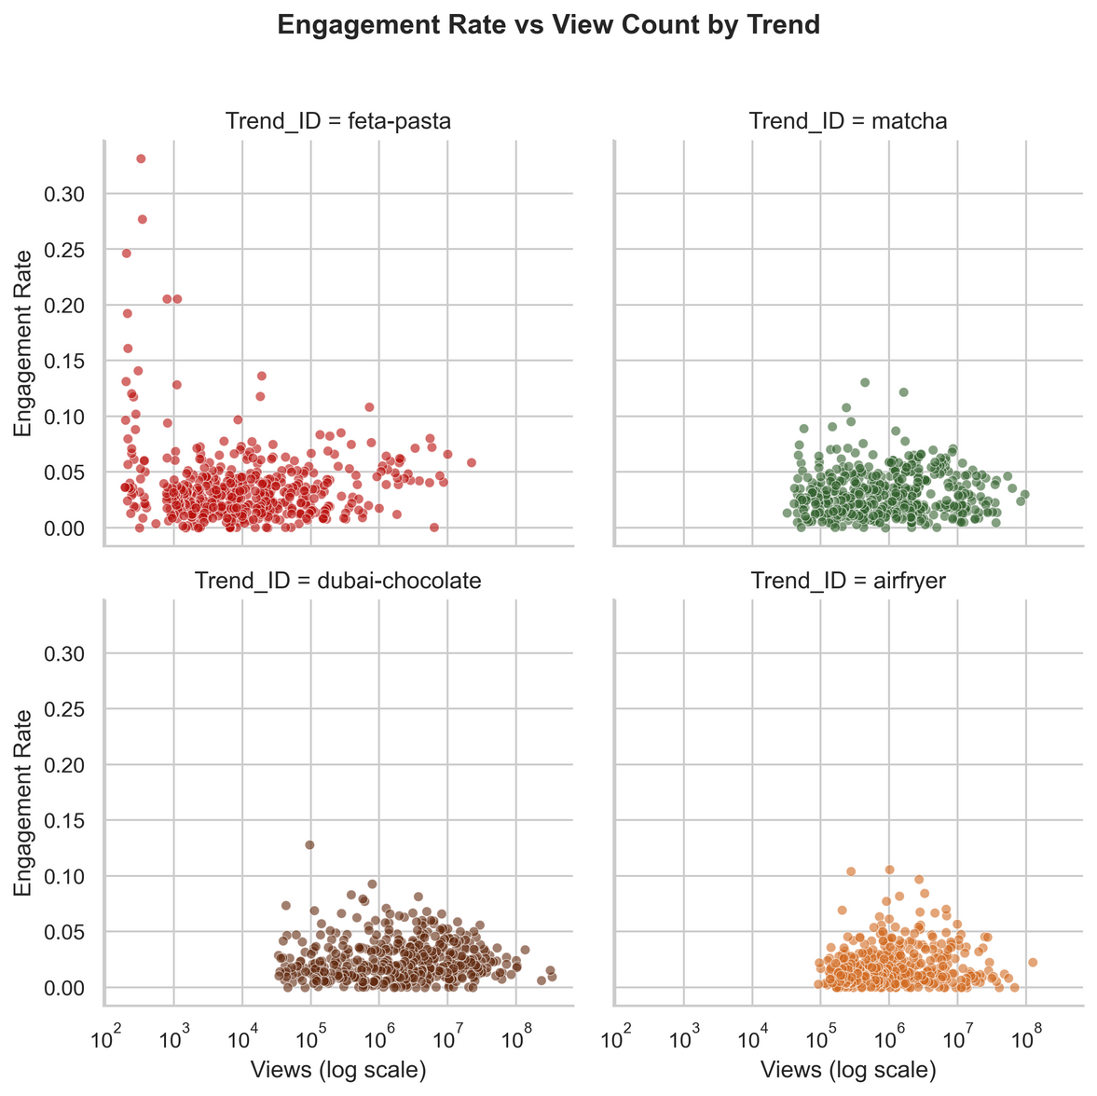
YouTube Audience Engagement Patterns
We analyzed engagement behavior across YouTube videos for each food trend to understand how audiences interact with trend-related content.
Across all four trends, engagement rates (likes + comments / views) remain relatively low. However, a few videos within each trend show unusually high engagement, highlighting how viral moments dominate overall visibility.
<5% average engagement rate across all trends
Viral outliers drive the majority of total audience interaction
Feta Pasta shows the highest engagement volatility

Slide 11




GEOGRAPHIC DIFFUSION OF FOOD TRENDS
We analyzed how food trends spread across four key regions using Google Trends data:
USA
India
UAE
South Korea

Slide 12
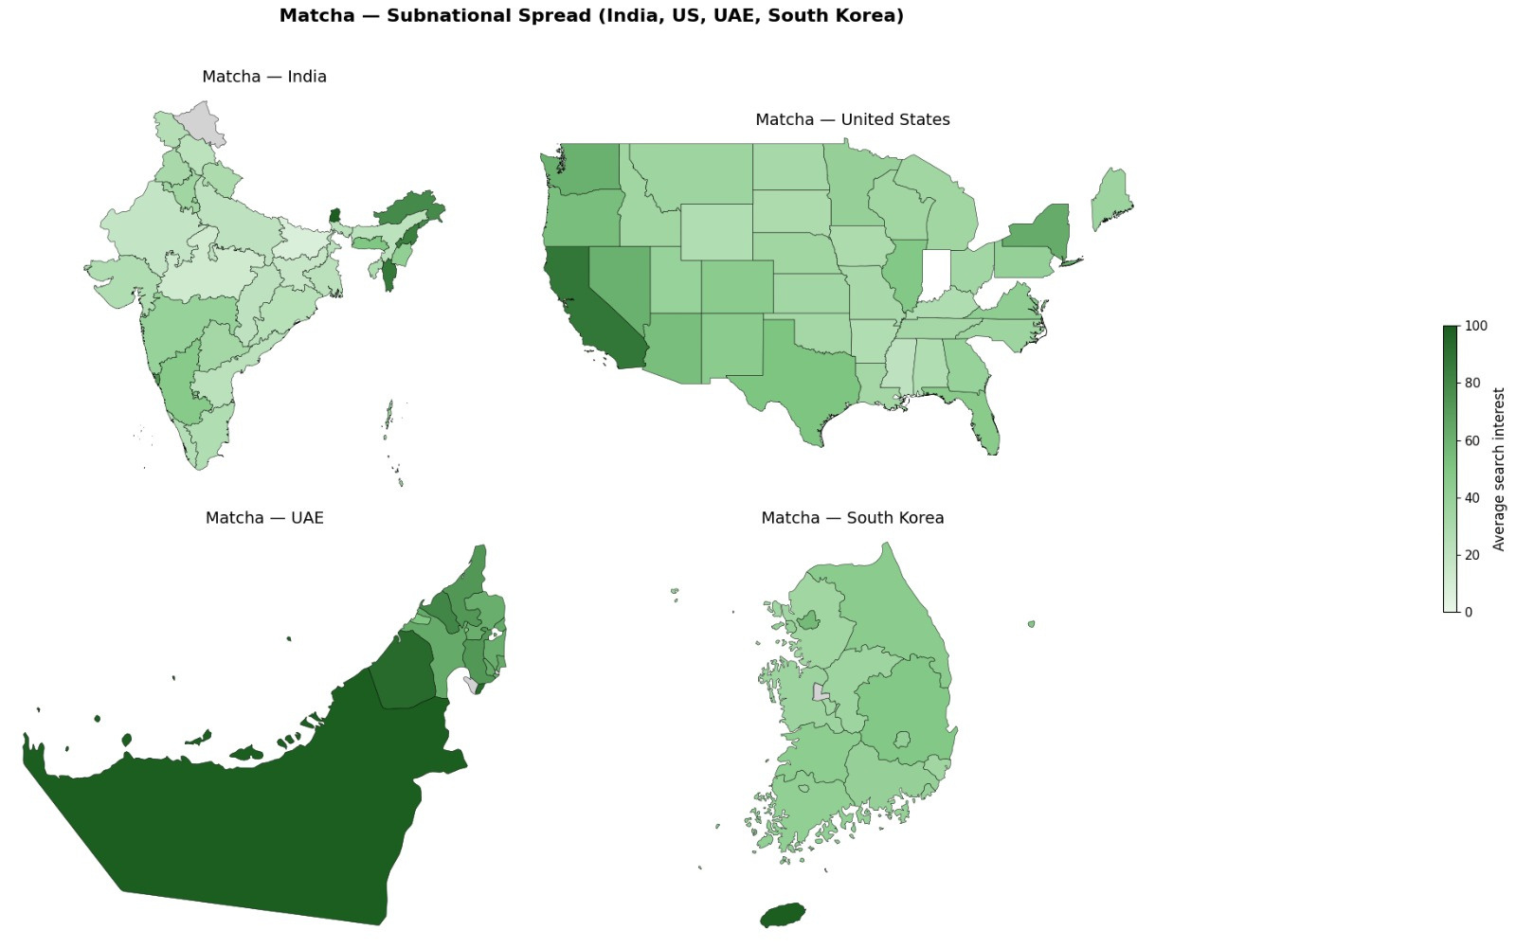

Interest is concentrated along the west and east coast where wellness, sustainability, and specialty beverages drive ongoing popularity.
Highest search interest in the Northeast and western-southern states indicating both tea-linked origins and emerging urban curiosity.
Strong, widespread interest nationwide
Matcha is well-established in both daily consumption and digital trend spaces.
High interest concentrated around Dubai, reflecting exposure to global food trends and premium import markets.
🍵Matcha
shows a broad, sustained adoption pattern across all four countries, indicating a mature, stable trend driven by global wellness awareness and product availability

Slide 13
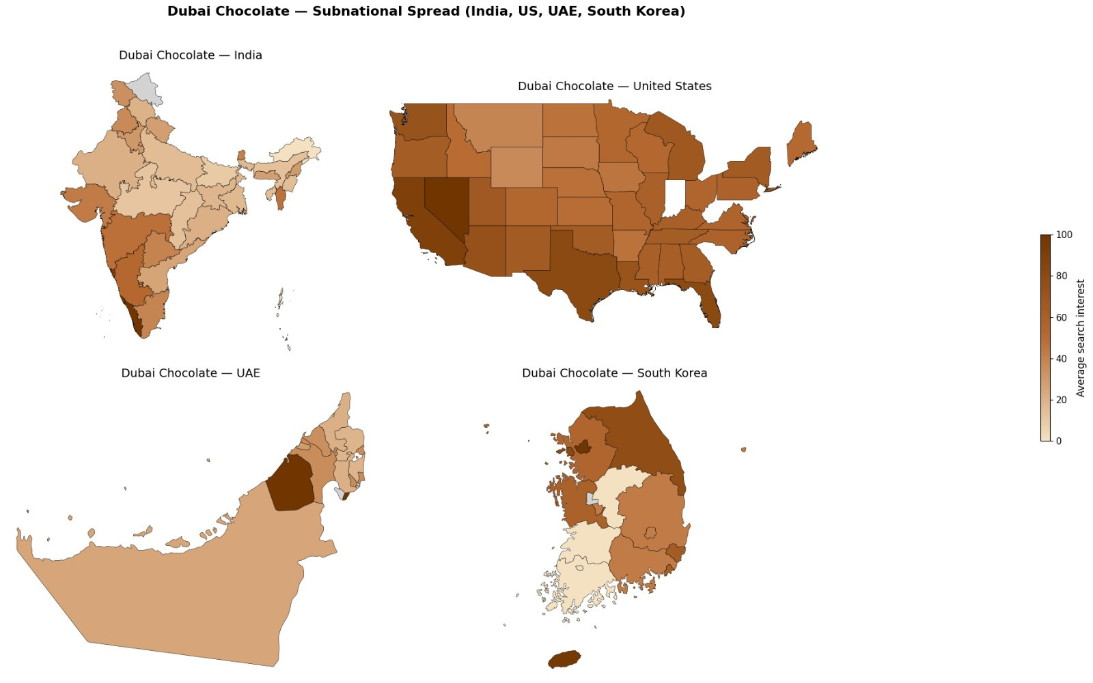
Fairly distributed engagement nationwide, with stronger activity in California, Nevada, Texas, and Florida, regions reflecting diverse consumer bases and active social media participation
Moderate engagement across western and southern states, showing early exposure via cross-border content and influencer marketing.
High interest in Seoul, Jeju Island, and northern provinces, suggesting the trend’s visibility through urban digital networks and niche luxury markets rather than mass adoption.
Highest concentration in Dubai, confirming the trend’s local origin as a premium, influencer-promoted confection.
🍫Dubai Chocolate
shows a local-to-global diffusion patterns, strong roots in the UAE, broad awareness in Western and Asian digital markets, and early traction in urban, trend-sensitive regions

Slide 14
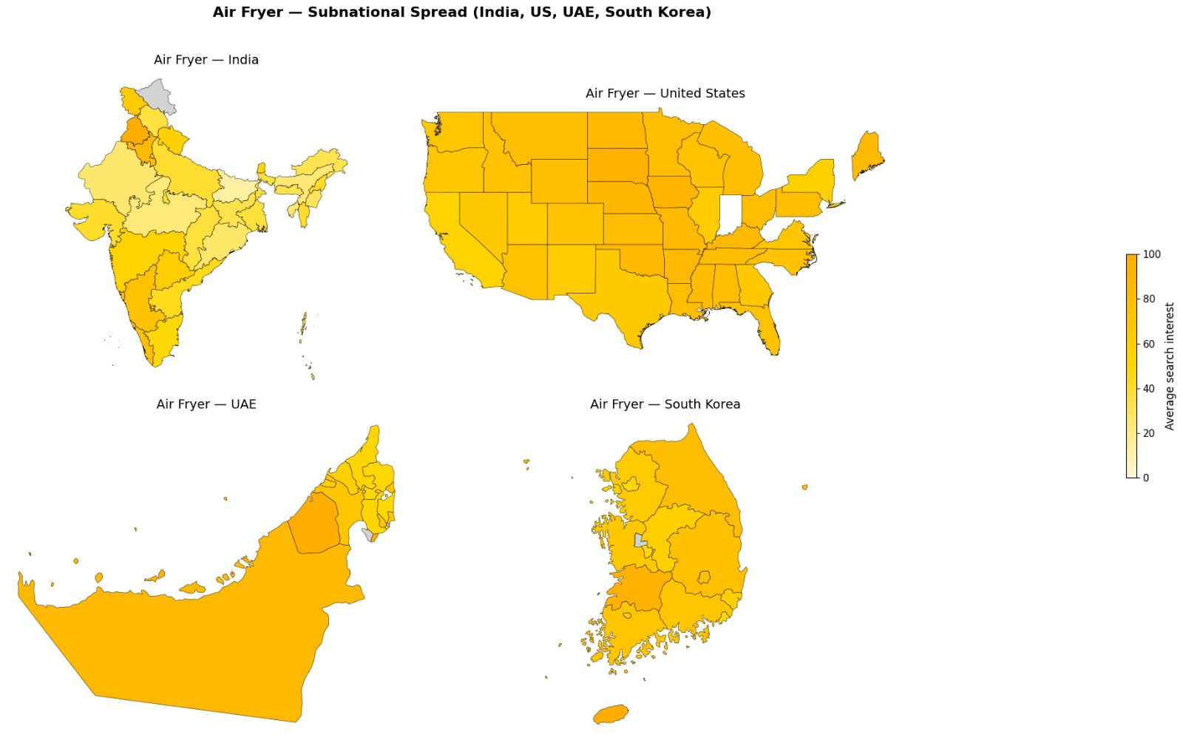

Even distribution nationwide, showing the Air Fryer’s transition from a novelty to a mainstream household product.
Highest search interest in southern, western states, and north most regions. This reflects the mainstream adoption of the appliance in urban households and rising awareness through digital marketplaces.
Strong national presence in Seoul and surrounding regions, confirming the trend’s integration into everyday cooking routines.
Air Fryer
demonstrates uniform, sustained adoption across all four regions, a mature, utility-based trend driven by convenience and practicality rather than social media virality.
Strong and consistent interest across all emirates, reflecting early adoption and continued household use, especially in urban centers like Dubai and Abu Dhabi.

Slide 15
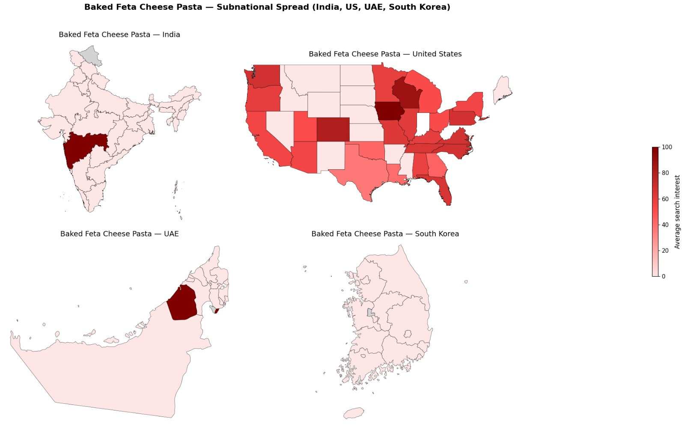
Strongest engagement in the Midwest extending into Northeastern states like New York, Massachusetts, and Pennsylvania, and Southeastern pockets such as Florida and Georgia. This aligns closely with the trend’s TikTok-driven viral spread during early 2021.
Strongest engagement in Maharashtra, suggesting that the trend reached digitally active, Western-influenced regions but didn’t spread widely across the country.
Minimal but visible activity throughout, reflecting short-lived curiosity driven by global exposure rather than local participation.
Highest concentration in Dubai, where the trend likely spread through social media virality and influencer content, not organic local adoption.
🧀Baked Feta Pasta
represents a short-lived, high-intensity viral event, originating in the U.S. Midwest and quickly spreading globally via social media before fading from mainstream attention..

Slide 16
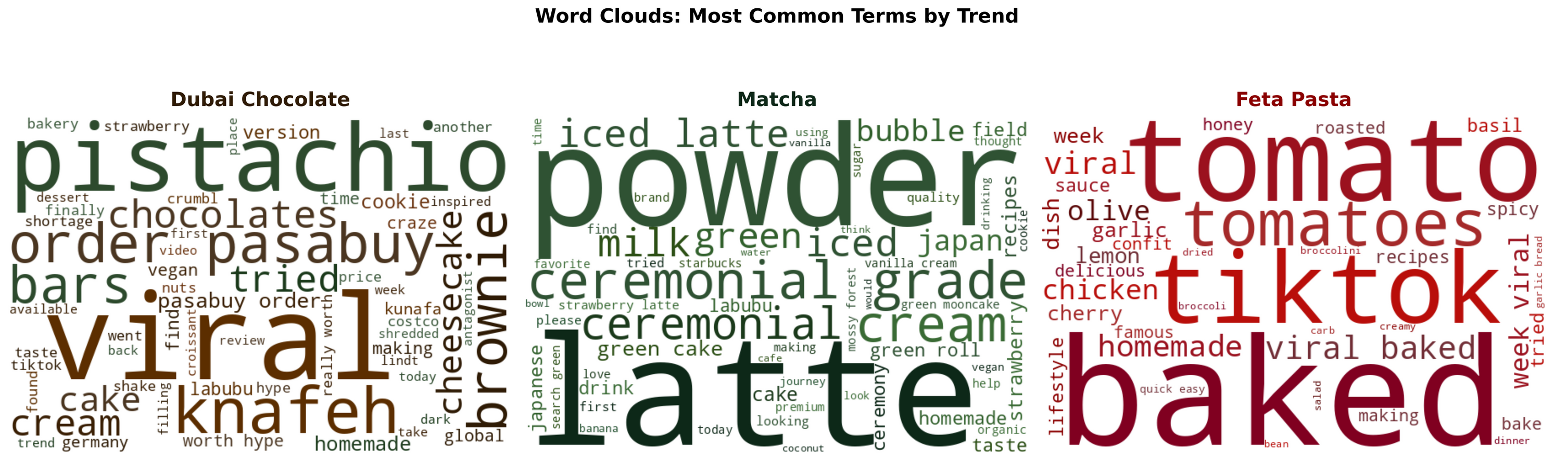
Word Frequency By Trend
Purchasing Driven Conversations
Product Focused Discussions
Recipe Creation Focus
Shopping language (“order”, “pasabuy”) & key ingredients (“pistachio”, “knafeh”)
Quality indicators (“ceremonial”, “powder”) & preparation terms (“latte”)
Recipe focused (“tomato”, “baked”) & viral origin (“tiktok”)

Slide 17
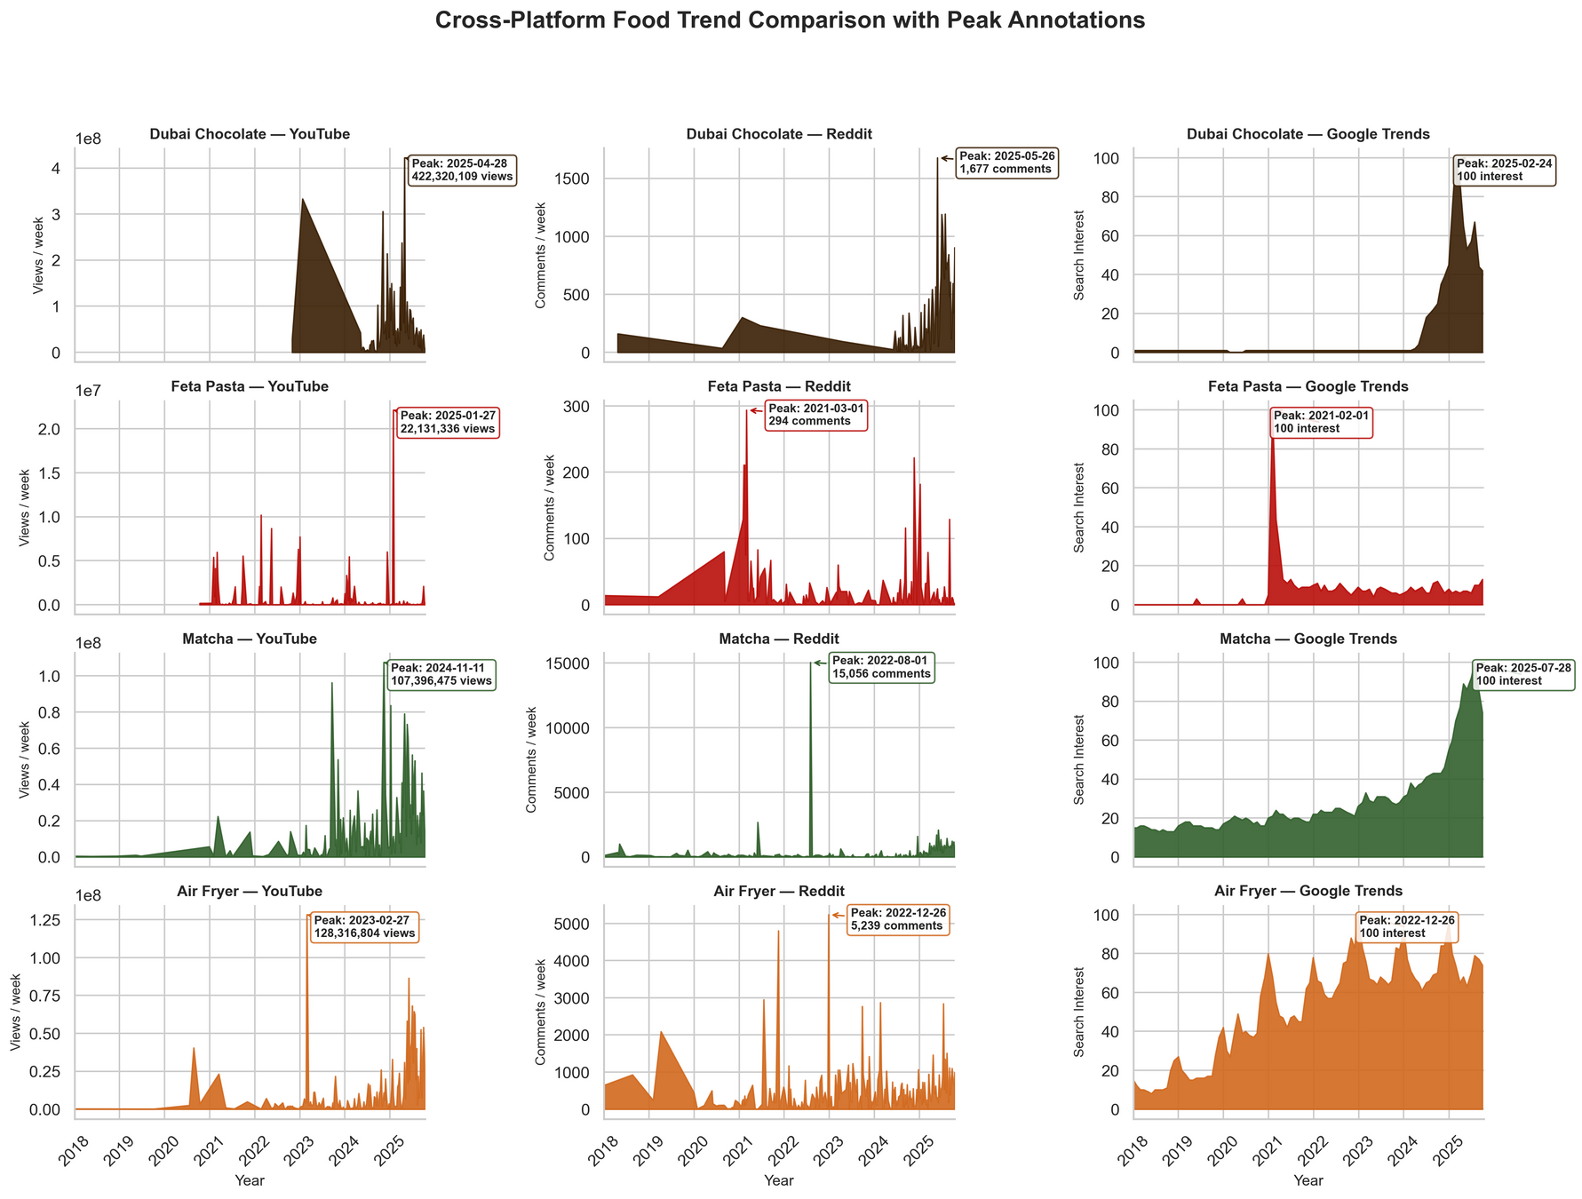
Cross Platform Trends
Each platform contributes differently: Google shows early curiosity, YouTube fuels visibility, and Reddit keeps the discussion alive. This sequence helps us see how some trends quickly fade while others build sustained engagement.
Google spikes first, signals public curiosity before content creation
YouTube amplifies visibility, video creation peaks 2–4 weeks after search surges
Reddit reacts last, community discussions sustain engagement after peaks fade

Slide 18
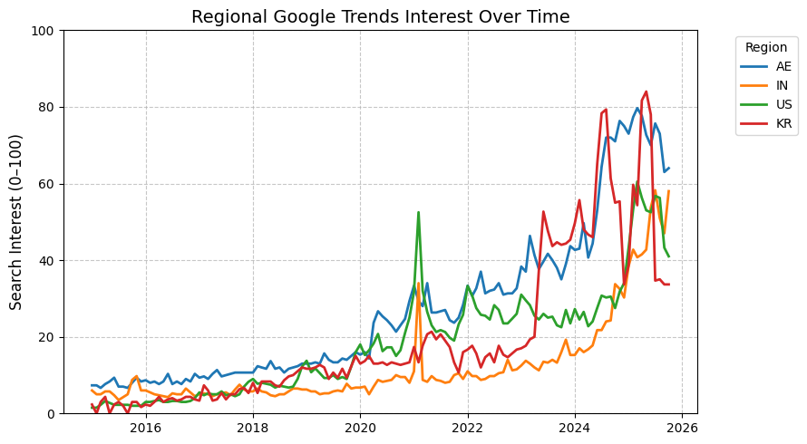
REGRESSION INSIGHTS FOR GOOGLE TRENDS
Results
Significant positive relationship between early engagement & later diffusion
Sentiment acts as a mediating factor for viral spread.
Trends with positive sentiment + high initial engagement spread more widely and sustain longer.
WHAT PREDICTS TREND DIFFUSION?

Slide 19
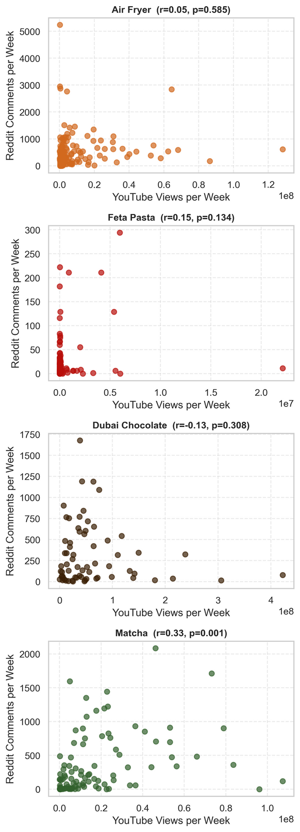
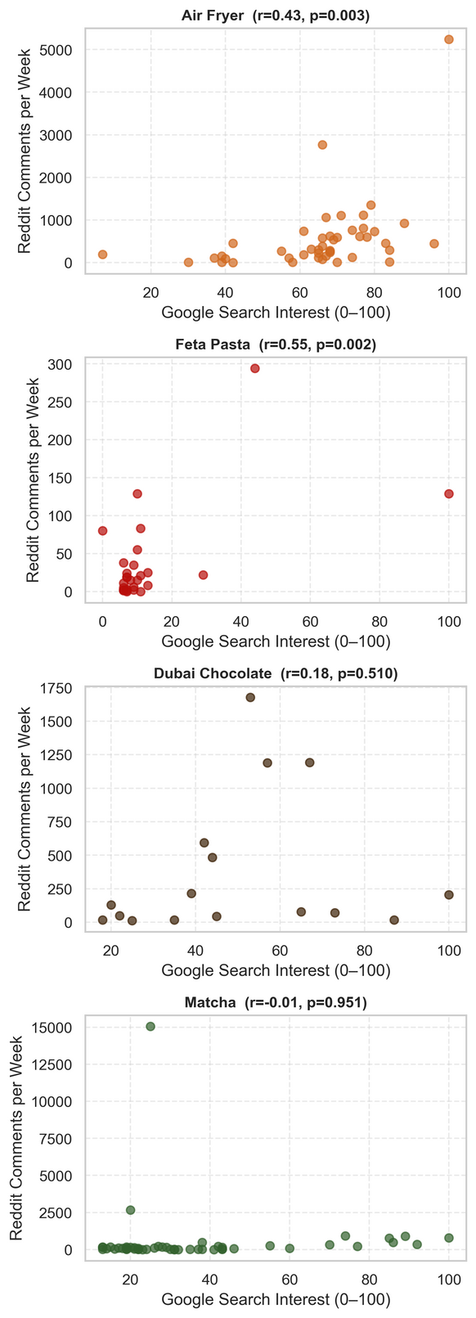
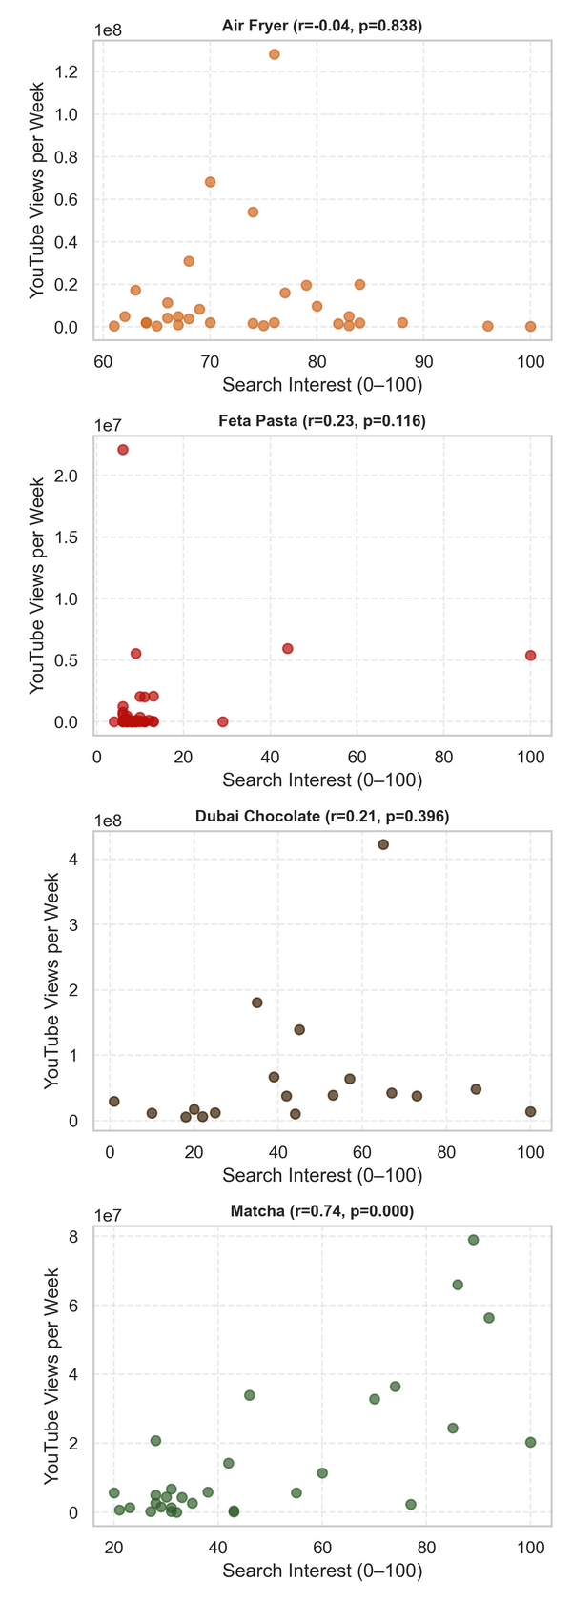
Cross-Platform Correlations
Linear regression tested relationships between search activity (Google Trends), video engagement (YouTube), and discussion intensity (Reddit) for each trend.
Key Findings:
Google ↔ YouTube: Matcha shows a strong positive correlation (r = 0.74, p < 0.001), curiosity aligns with content creation.
Google ↔ Reddit: Feta Pasta (r = 0.55) and Air Fryer (r = 0.43) show moderate positive links between search interest and discussions.
YouTube ↔ Reddit: Matcha shows a modest but significant correlation (r = 0.33), reflecting sustained, multi-platform engagement.
Dubai Chocolate shows weak or insignificant correlations, indicating it’s still an emerging trend.
YouTube and Reddit
Reddit and Google Trends
Google Trends and YouTube

Slide 20
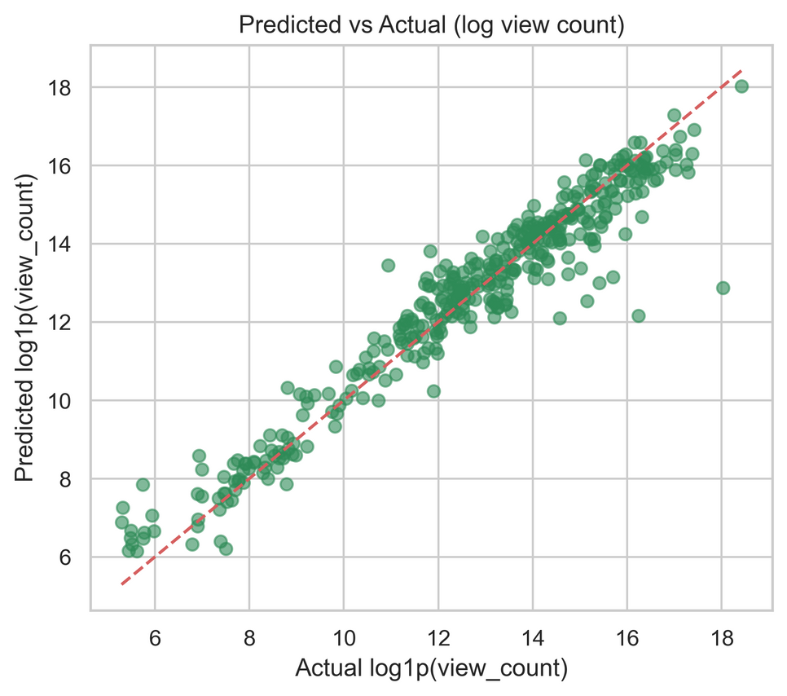
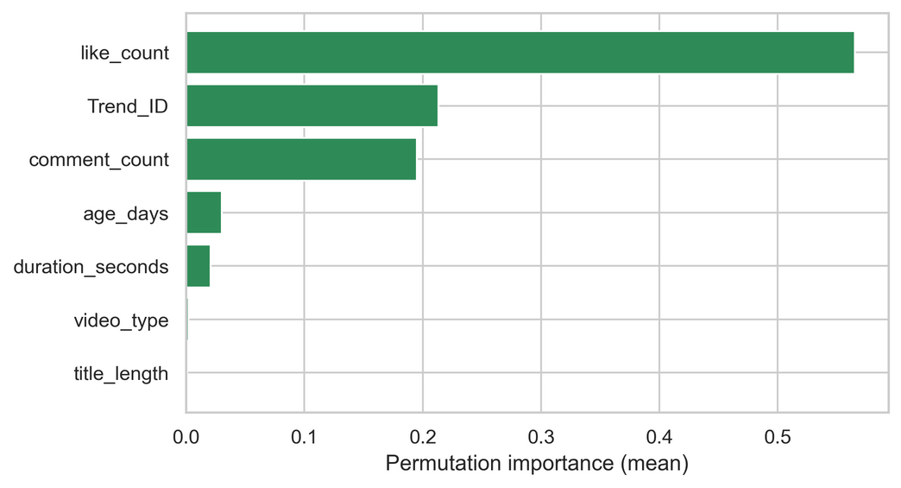
Random Forest Results
The Random Forest model showed strong predictive accuracy with R² = 0.94 and an RMSE of 0.696, indicating that early engagement reliably explains YouTube visibility. Likes and comment count emerged as the most influential predictors, while structural video features such as duration or title length contributed minimally. These results indicate that early audience interaction is what drives a trend’s algorithmic reach.

Slide 21
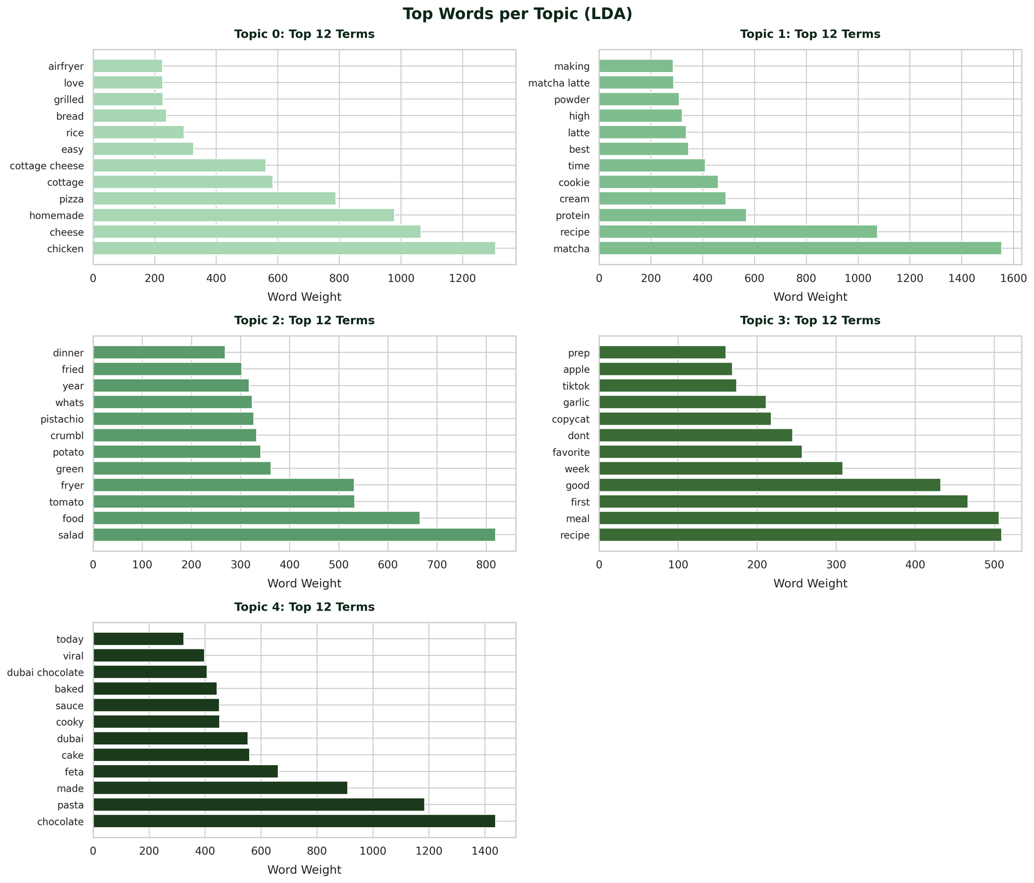
TOPIC MODELING (LDA) RESULTS
Topic 0: Cooking/preparation of high protein meals
Topic 1: Matcha/drink preparation & experimentation
Topic 2: Air Fryer recipes
Topic 3: Step-by-step recipes
Topic 4: Novelty/Viral Foods

Slide 22
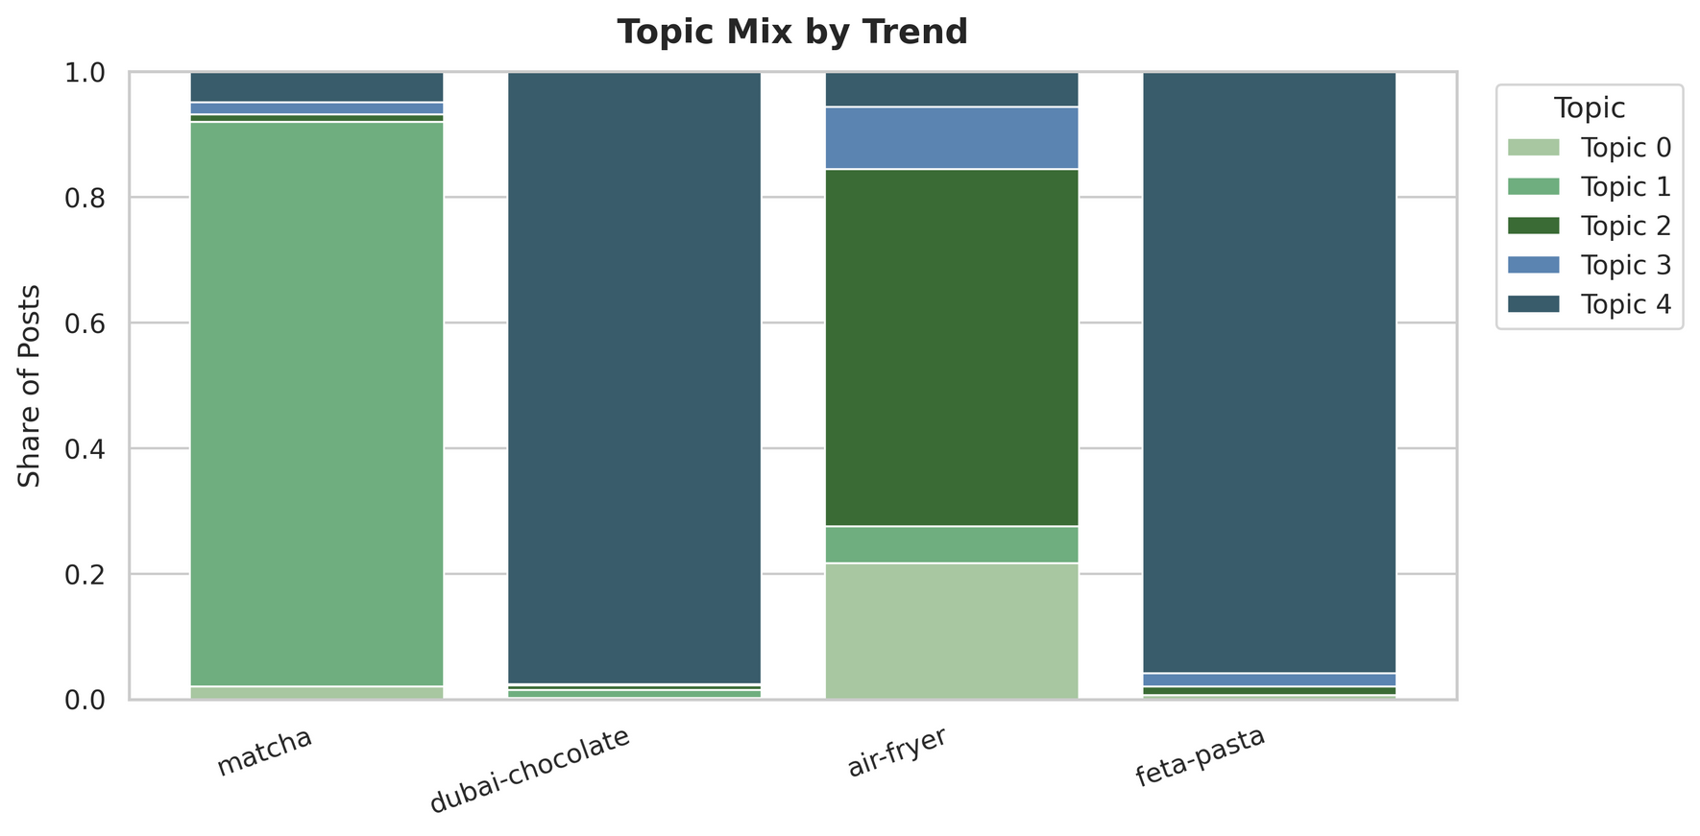
TOPIC MODELING (LDA) RESULTS
Matcha - dominated by Topic 1 (Matcha/drink preparation)
Dubai Chocolate & Air Fryer - almost entirely composed of Topic 4 (Novelty/Viral Trends)
Air Fryer - relatively balanced spread across all topics
Discussion

Slide 23
What Our Results Reveal
RQ2: Can Early Signals Predict Popularity and Longevity
RQ1: What Drives the Rise and Decline of Food Trends?
RQ3: How Do Food Trends Spread Across Regions and Platforms
Resultado Principal
Yes, early engagement and sentiment are good predictors of how far a trend spreads. Higher initial likes, comments, and positive tone can forecast greater visibility and regional diffusion. Early momentum is a key indicator of whether a trend becomes lasting or fades quickly
Results show that food trends follow different lifecycle patterns shaped by engagement behavior and cultural relevance. Some trends rise and fall quickly (like Feta), while others grow steadily and sustain interest (Matcha, Air Fryer). Differences reflect how novelty, utility, and influencer visibility shape a trend’s path.
Trends diffuse differently across countries and platforms. Google captures early curiosity, YouTube increases visibility, and Reddit sustains discussion after peaks fade. Geographic patterns show that some trends spread widely while others remain localized or niche.

Slide 24
Online platforms compress trend adoption lifecycle
Trends follow S-curve with overlapping user groups
Platforms map onto stages:
Google → curiosity
YouTube → growing visibility
Reddit → discussion
3 data sources provides complete lifecycle picture
Search to visibility to conversation forms a predictable sequence
Early signals help predict later engagement
Approach is reproducible and fits social science standards
THEORETICAL
IMPLICATIONS
SCIENTIFIC AND
METHODOLOGICAL
IMPLIFICATIONS
Digital data is not globally representative
Viral trends affect real world behavior & markets
Algorithms shape what is popular
Need to acknowledge unequal online participation
Only 3 platforms creates a partial view shaped by algorithms
Limited trends and locations analyzed
LDA & Vader may miss nuance and humor in text
Platforms report data differently
ETHICAL AND SOCIETAL
IMPLICATIONS
LIMITATIONS

Slide 25


Future Applications
Our framework for analyzing online food trends can be applied to forecasting emerging trends, informing marketing strategies, and supporting product development for food and retail industries.
With integration of additional platforms like TikTok and Instagram, this approach can offer even more accurate and early identification of trends.

Slide 26
References
Abbar, S., Mejova, Y., & Weber, I. (2015). You tweet what you eat: Studying food consumption through twitter. arXiv preprint arXiv:1412.4361. https://arxiv.org/abs/1412.4361
Cash, S. B., Alhabash, S., Fretes, G., & Ma, M. (2022). Food, beverages and social media: trends and tools for economic research. In A Modern Guide to Food Economics. Edward Elgar Publishing. https://doi.org/10.4337/9781800372054.00022
Drescher, L. S., Grebitus, C., & Roosen, J. (2023). Exploring food consumption trends on twitter with social media analytics: The example of #veganuary. Journal of Consumer Affairs. https://doi.org/10.1111/1746-692X.12403
Fried, D., Surdeanu, M., Kobourov, S., Hingle, M., & Bell, D. (2014). Analyzing the language of food on social media. arXiv preprint arXiv:1409.2195. https://arxiv.org/abs/1409.2195
Google. (2023). YouTube Data API v3. https://developers.google.com/youtube/v3
Khulbe, D., & Pathak, M. (2019). Modeling food popularity dependencies using social media data. arXiv preprint arXiv:1906.12331. https://arxiv.org/abs/1906.12331
Patat, D. (2023). pytrends: Unofficial API for Google Trends. GitHub. Retrieved October 2, 2025, from https://github.com/pat310/google-trends-api
Reddit, Inc. and PRAW Authors. (2023). PRAW: The Python Reddit API Wrapper. https://praw.readthedocs.io/en/latest/
Rogers, E. M. (1983). Diffusion of innovations (3rd ed.). The Free Press. https://teddykw2.wordpress.com/wp-content/uploads/2012/07/everett-m-rogers-diffusion-of-innovations.pdf
Saura, J. R., Reyes-Menendez, A., & Thomas, S. B. (2020). Gaining a deeper understanding of nutrition using social networks and user-generated content. Internet Interventions, 20, 100312. https://doi.org/10.1016/j.invent.2020.100312
Shan, Y., Wang, H., & Wang, W. (2025). Food neophobia: psychological dimensions of consumer perception and emotional sentiment in social media discourse. Frontiers in Nutrition, 12. https://doi.org/10.3389/fnut.2025.1584409
Simmel, G. (1957). Fashion. The American Journal of Sociology, 62(6). https://smg.media.mit.edu/library/Simmel.fashion.pdf
Swartz, D. (1997). Culture and power: The sociology of Pierre Bourdieu. University of Chicago Press. https://www.gacbe.ac.in/images/E%20books/Culture%20and%20Power%20-%20The%20Sociology%20of%20Pierre%20Bourdieu%20.pdf
McHugh-Johnson, M. (2021, March 8). You feta believe it: Search trends. The Keyword. https://blog.google/products/search/you-feta-believe-it-search-trends/

